Slide 1
Chapter Five
Queue

Slide 2
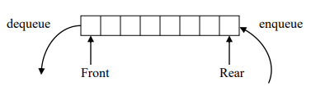
Queues
A data structure that has access to its data at the front and rear.
Operates on FIFO (Fast In First Out) basis.
Uses two pointers/indices to keep tack of information/data.
Has two basic operations:
Enqueue - inserting data at the rear of the queue
Dequeue – removing data at the front of the queue

Slide 3
Simple array implementation of enqueue and dequeue operations
int MAX_SIZE=100;
int FRONT =-1, REAR =-1;
int QUEUESIZE = 0;
void enqueue(int x){
if(Rear<MAX_SIZE-1) {
REAR++;
Num[REAR]=x;
QUEUESIZE++;
if(FRONT = = -1)
FRONT++;
}
Else
cout<<"Queue Overflow";
}
int dequeue(){
int x;
if(QUEUESIZE>0) {
x=Num[FRONT];
FRONT++;
QUEUESIZE--;
}
else
cout<<"Queue Underflow";
}

Slide 4
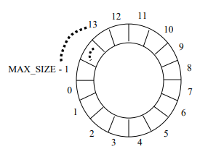
Circular array implementation of enqueue and dequeue operations
A problem with simple arrays is we run out of space even if the queue never reaches the size of the array.
Thus, simulated circular arrays (in which freed spaces are re-used to store data) can be used to solve this problem.
The circular array implementation of a queue with MAX_SIZE can be simulated as follows:

Slide 5
Cont..
void enqueue(int i){
if(size<n){
rear=rear+1;
if(rear==n)
rear=0;
queue[rear]=i;
if(front==-1)
front=front+1;
size++;
}
else
{
cout<<"the queue is full"<<endl;
}
}

Slide 6
Linked list implementation of enqueue and dequeue operations
Enqueue- is inserting a node at the end of a linked list
Dequeue- is deleting the first node in the list

Slide 7
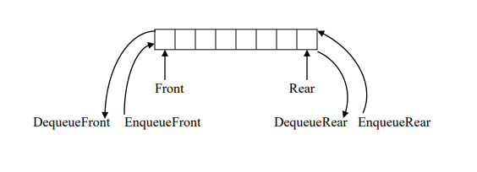
Deque
It is a Double Ended Queue
Iinsertion and deletion can occur at either end
Has the following basic operations
EnqueueFront – inserts data at the front of the list
DequeueFront – deletes data at the front of the list
EnqueueRear – inserts data at the end of the list
DequeueRear – deletes data at the end of the list
The implementation is similar to that of queue
It is best implemented using doubly linked list

Slide 8

Priority queues
It is a queue where each data has an associated key that is provided at the time of insertion.
Dequeue operation deletes data having highest priority in the list
One of the previously used dequeue or enqueue operations has to be modified
Example: Consider the following queue of persons where females have higher priority than males (gender is the key to give priority).
Dvequeue()- deletes Aster

Slide 9



Cont..
Dequeue()- deletes Meron
Now the queue has data having equal priority and dequeue operation deletes the front element like in the case of ordinary queues.
Dequeue()- deletes Abebe
Dequeue()- deletes Alemu
Thus, in the above example the implementation of the dequeue operation need to be modified.

Slide 10
Application of Queues
Print server- maintains a queue of print jobs
Print(){
EnqueuePrintQueue(Document)
}
EndOfPrint(){
DequeuePrintQueue()
}
Disk Driver- maintains a queue of disk input/output requests
Task scheduler in multiprocessing system- maintains priority queues of processes
Telephone calls in a busy environment –maintains a queue of telephone calls
Simulation of waiting line- maintains a queue of persons

